Slide 1

Data Structures and Algorithms
Notes on Constraint Satisfaction Problems

Slide 2
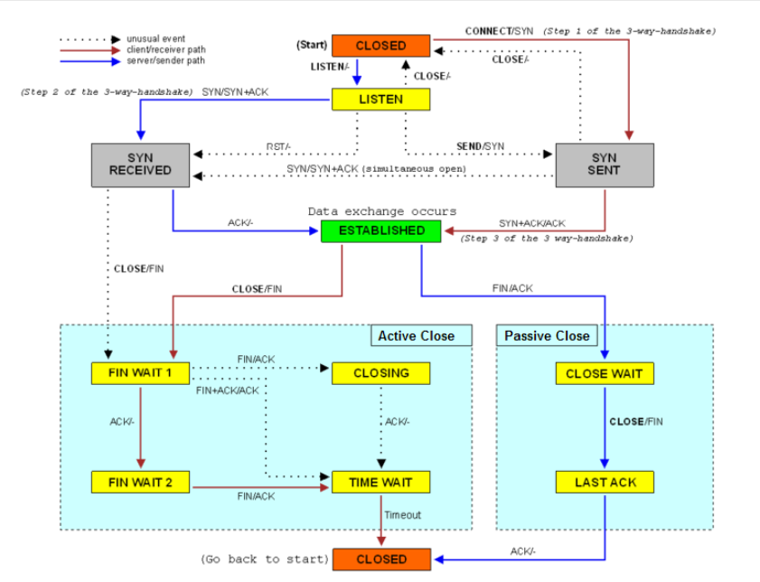
States
Many systems and protocols can be described by state machines. Makes for easy programming and analysis.
TCP diagram from
Wikipedia commons
Nodes
Edges
Easy to map
to graph

Slide 3
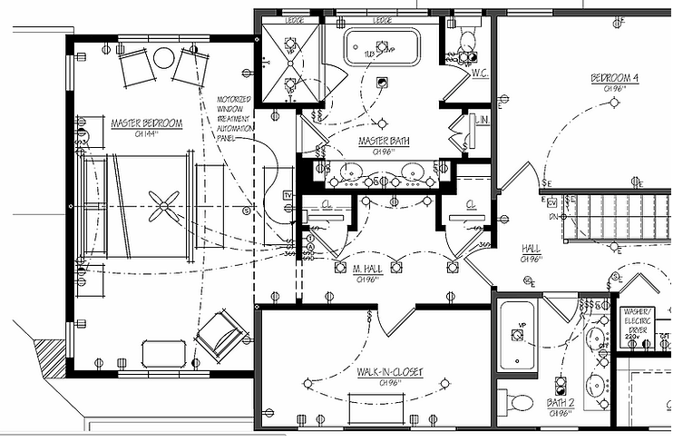
States vs. Variables
State of system = ∪ state of each switch, light, etc.

Slide 4
States vs. Variables
If there are n items, each of which can have s states, there are s^{n} states in the system.
That’s a lot.
On the other hand, if you define each item as a variable, you can reason about them independently.
The switch in the master bedroom and the kitchen light have little to do with each other.
Unless the power is out.
Much easier to reason with variables.
Graphs are still useful in this situation.

Slide 5
Constraints
A scope is a set of variables. A relation on a scope S maps assignments of the variables in S to {T,F}. A constraint is a scope S and a relation on S. A constraint involves each variable in its scope.
A constraint can be evaluated on any assignment that extends its scope. Consider constraint c on S. Assignment A on S′, where S⊆S′, satisfies c if A, restricted to S, is mapped to true by the relation. Otherwise, the constraint is violated by the assignment.

Slide 6
Constraints - Example
A primary example for constraint satisfaction will be college courses necessary to complete a CS degree.
The scope S’ could be the set of courses you take to earn a degree.
The scope S ⊆ S’ could be the set of courses needed for the CS major.
A relation could map the courses you’re going to take to the semesters in which you will take them.
A constraint could be something like “take ICS 340 before ICS 440”.

Slide 7
Constraints Intension vs. Extension
Constraints can be defined in terms of formulas (their intension):
ICS 240 < ICS 340 (here “<“ means “must take before”)
ICS 340 < ICS 440
Constraints could also be defined by an enumeration of all true assignments (their extension):
When to take ICS 240, 340, 440 to graduate Fall 2022:
240 | Su21 | Su21 | Su21 | Fa21 | Su21 | Su21 | Fa21 | Su21 | Fa21 | Sp22
340 | Fa21 | Fa21 | Sp22 | Sp22 | Fa21 | Sp22 | Sp22 | Su22 | Su22 | Su22
440 | Sp22 | Su22 | Su22 | Su22 | Fa22 | Fa22 | Fa22 | Fa22 | Fa22 | Fa22

Slide 8
Constraint Satisfaction Problem
A constraint satisfaction problem (CSP) is characterized by:
A set of variables V₁, V₂, …, V_{n}
Each variable V_{i} has an associated domain D_{i} of possible values.
There are hard constraints on various subsets of the variables which specify legal combinations of values for these variables.
A hard constraint is one that must be satisfied by a solution.
A solution to the CSP is an assignment of a value to each variable that satisfies all the constraints.

Slide 9
Example: Scheduling Activities
Variables: A, B, C, D, E represent times of various activities.
Domains: D_{A} = D_{B} = D_{C} = D_{D} = D_{E} = {1, 2, 3, 4}
Constraints (“and” of all these constraints):
B != 3
C != 2
A != B
B != C
C < D
A = D
E < A
E < B
E < C
E < D
B != D

Slide 10
Example: Scheduling Classes
Suppose you want to take ICS 311, 340, 365, 372 next semester.
Domains:
D₃₁₁ = {M,W,H}
D₃₄₀ = {M,T}
D₃₆₅ = {M,W}
D₃₇₂ = {H}
Hard constraint is no two courses taken at the same time. Let N(nnn) be the night you take course N. Then the constraints are:
N(311) != N(340)
N(311) != N(365)
N(311) != N(372)
N(340) != N(365)
N(340) != N(372)
N(365) != N(372)

Slide 11
Generate-and-Test Algorithm
Mindless way to solve a CSP.
Basically, try every solution (brute force)
Generate the assignment space D = D₁ × D₂ … D_{n}
Test each assignment with the constraints.
Previous example
D = D_{A} × D_{B} × D_{C} × D_{D} × D_{E}
= {1,2,3,4} × {1,2,3,4} × {1,2,3,4} × {1,2,3,4} × {1,2,3,4}
= {(1,1,1,1,1), (1,1,1,1,2), …, (4,4,4,4,4)}
How many assignments need to be tested for n variables each with domain size d? d^{n}
If there are c constraints to test, this is O(cd^{n}). Yikes.

Slide 12
Generate and Test for Scheduling Classes
Test each assignment with the constraints.
Previous example (N311, N340, N365, N372)
D = D₃₁₁ × D₃₄₀ × D₃₆₅ × D₃₇₂
= {M,W,H} × {M,T} × {M,W} × {H}
= {(M,M,M,H), (M,M,W,H), (M,T,M,H), (M,T,W,H), (W,M,M,H), (W,M,W,H), (W,T,M,H), (W,T,W,H), (H,M,M,H), (H,M,W,H), (H,T,M,H), (H,T,W,H) }
12 possibilities, not too bad
Two possibilities work: (M,T,W,H) and (W,T,M,H)

Slide 13
Backtracking Algorithms
Systematically explore D by instantiating the variables one at a time.
Evaluate each constraint predicate as soon as all its variables are bound.
Any partial assignment that doesn’t satisfy the constraint can be pruned.
Example: Assignment (A=1) & (B=1) is inconsistent with constraint A != B, regardless of the value of any other variable.

Slide 14
Backtracking for Scheduling Classes
D = D₃₁₁ × D₃₄₀ × D₃₆₅ × D₃₇₂
= {M,W,H} × {M,T} × {M,W} × {H}
= {(M,M,M,H), (M,M,W,H), (M,T,M,H), (M,T,W,H), (W,M,M,H), (W,M,W,H), (W,T,M,H), (W,T,W,H), (H,M,M,H), (H,M,W,H), (H,T,M,H), (H,T,W,H) }
Try like this:
N(311) = M
N(311) = M, N(340)=M X
N(311) = M, N(340)=T , N(365) = M X
N(311) = M, N(340)=T , N(365) = W, N(372)=H

Slide 15
Graph Searching to Solve CSP (method 1)
A node is an assignment of values to some of the variables.
Suppose node N is the assignment X₁=v₁, …, X_{k}=v_{k}
Select a variable Y that isn’t assigned in N.
For each value y_{i} ∈ dom(Y), X₁=v₁, …, X_{k}=v_{k}, Y=y_{i} is a neighbor if it is consistent with the constraints.
The start node is the empty assignment.
A goal node is a total assignment that satisfied the constraints.
Here is a case where the graph is built “on the fly”.

Slide 16
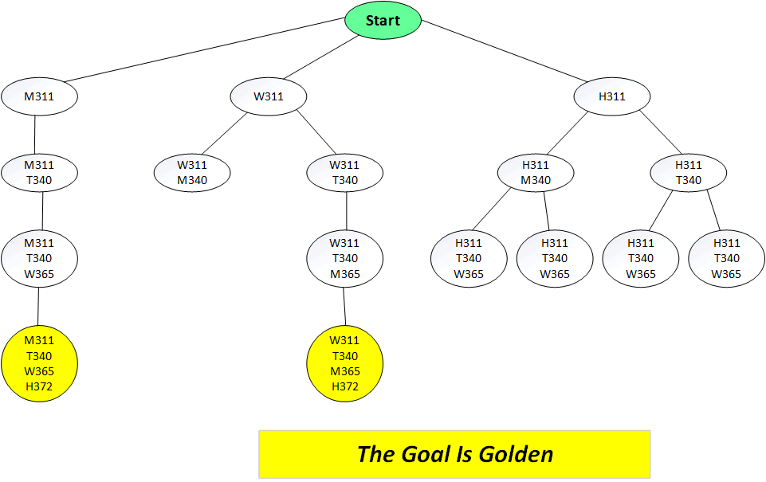
Graph Searching to Solve CSP (for classes)

Slide 17
Consistency Algorithms
These can also use graphs
Idea: Prune the domains as much as possible before selecting values from them.
A variable is domain consistent if no value of the domain of the node is ruled impossible by any of the constraints.

Slide 18
Are any/all these variables domain consistent?
Variables: A, B, C, D, E represent times of various activities.
Domains: D_{A} = D_{B} = D_{C} = D_{D} = D_{E} = {1, 2, 3, 4}
Constraints (“and” of all these constraints):
B != 3
C != 2
A != B
B != C
C < D
A = D
E < A
E < B
E < C
E < D
B != D
B can’t be 3, C can’t be 2, so these are not domain consistent.
Actually, none are, as we shall see shortly. (Or look at E)

Slide 19
Constraint Network Graph (I)
There is an oval-shaped node for each variable.
There is a rectangular node for each constraint.
This is optional, some of us skip it
But useful in the GAC algorithm (later)
There is a domain of values associated with each variable node.
There is an arc from variable X to each constraint that involves X.

Slide 20
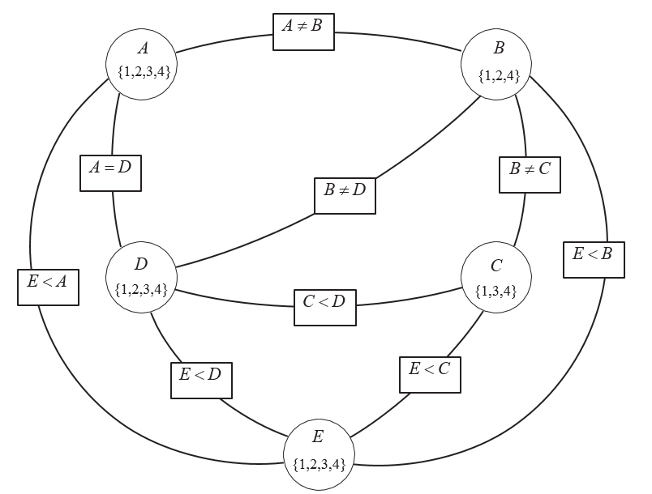
Example

Slide 21
Arc Consistency
An arc (X,r(X,Y)) is arc consistent if, for each value x∈dom(X), there is some value y∈dom(Y) such that r(x,y) is satisfied.
Arc (X,r(X,Y)) is different from Arc (Y,r(X,Y))
A network is arc consistent if all its arcs are arc consistent.
What if arc (X,r(X,Y)) is not arc consistent?
All values of X in dom(X) for which there is no corresponding value in dom(Y) can be deleted from dom(X) to make the arc (X,r(X,Y)) consistent

Slide 22
Arc Consistency Note
The arcs can be considered in turn making each arc consistent.
Note that each arc reflects one variable at one end of the arc, not both variables.
Note that (X,r(X,Y)) can be arc consistent while (Y,r(X,Y)) is not.
Example:
A = {1,2,3,4}, B = {1,2,3,4}, constraint A < B.
Arc (A,r(A,B)) is consistent if we remove A=4
Arc (B,r(A,B)) is consistent if we remove B=1
These are two separate steps

Slide 23
Arc Consistency Algorithm
When an arc has been made consistent, does it ever need to be checked again?
An arc (X,r(X,Y)) needs to be revisited if the domain of one of the Y’s is reduced.

Slide 24
Example – Let’s Do This

Slide 25
Arc Consistency Algorithm Result
There are three possible outcomes when all arcs are made arc consistent.
One domain is empty ➔ no solution
Each domain has a single value → unique solution
Some domains have more than one value → zero, one, or multiple solutions

Slide 26
Finding Solutions in case 3
If some domains have more than one element, search.
Or Generate and test
Variable elimination
Or anything else
Often split one domain in half, then solve for each half
Or maybe even try each value of a domain separately

Slide 27
Example Crossword Puzzle (I)
1 |  | 2
3
 |  | 4
Could have each variable be a box, with the edges connecting legal letters in the rest of the word.
E.g.,
r(1,2) = { (a,t), (b,g), (b,s), (c,r), (h,s) }
r(1,3) = { (b,o), (b,y), (h,l), (l,n), (y,a) }
r(2,4) = { (g,e), (s,c), (s,o), (s,a) }
Words: ant, big, bus, car, has, book, buys, hold, lane, year, beast, ginger, search, symbol, syntax

Slide 28
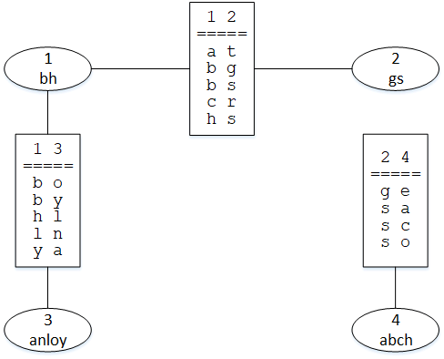
Example Crossword Puzzle (I)
1 |  | 2
3
 |  | 4
Words: ant, big, bus, car, has, book, buys, hold, lane, year, beast, ginger, search, symbol, syntax

Slide 29
Example Crossword Puzzle (II)
1 |  | 2
3
 |  | 4
Could have each variable be a word, with the edges giving the relationships between each word
E.g.,
r(1-across, 1-down) = must start with same letter
r(1-across, 2-down) = end of 1-across = start of 2-down
Words: ant, big, bus, car, has, book, buys, hold, lane, year, beast, ginger, search, symbol, syntax

Slide 30
Hard and Soft Constraints
A generalization of the previous problem
Given a set of variables, assign a value to each variable that either
Satisfies some set of constraints: satisfiability problems: only hard constraints
Minimizes some cost function, where each assignment of values to variables has some cost: optimization problems: may have hard and soft constraints.
Many problems are a mix of hard and soft constraints

